Slide 1
Crop Production Analysis
Samuel Nadar

Slide 2
Introduction

Slide 3
The Agriculture business domain, as a vital part of the overall supply chain, is expected to highly evolve in the upcoming years via the developments, which are taking place on the side of the Future Internet.
This dataset provides a huge amount of information on crop production in India ranging from several years.

Slide 4

Formula
Crop Density $= \frac{Crop Production}{Land Area}$
Crop Production α Land Area

Slide 5
Technology Stack

Slide 6






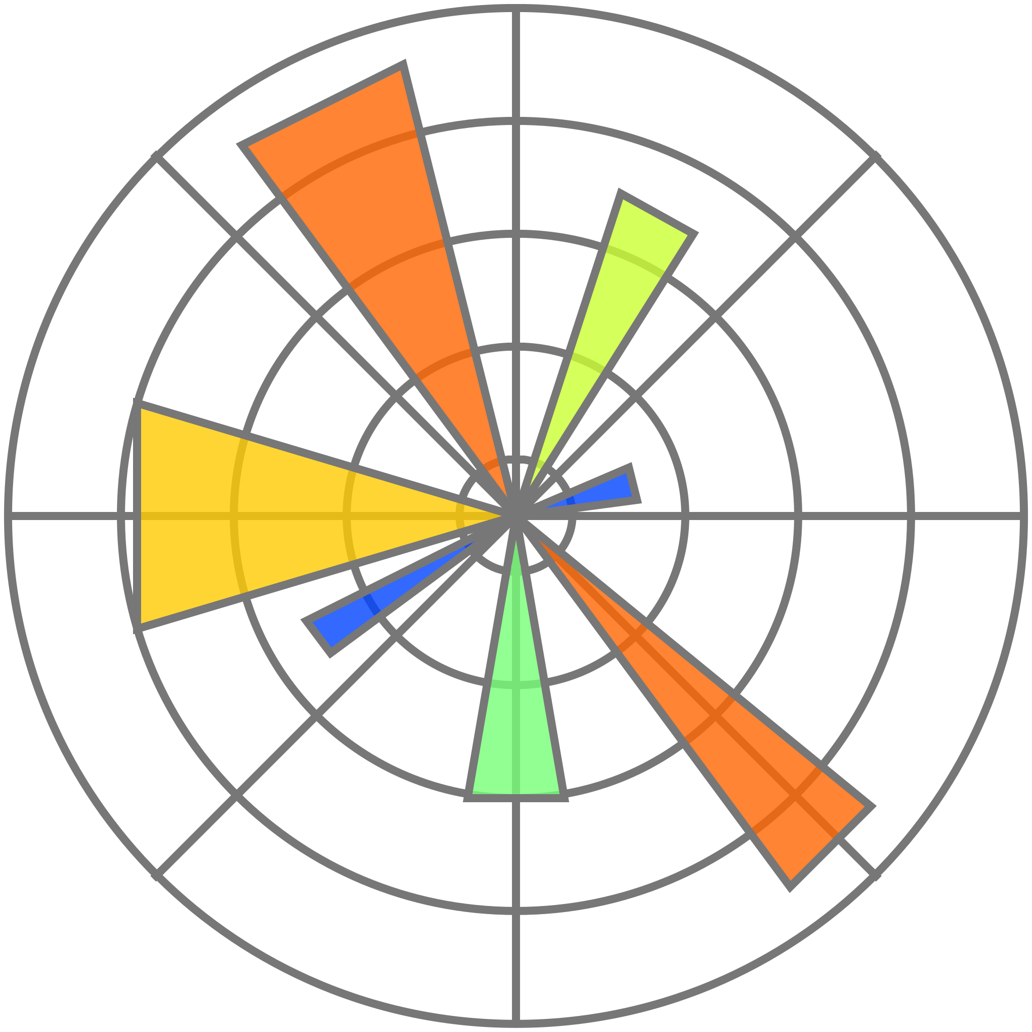







Slide 7
Steps in Data Analytics

Slide 8
Data Preprocessing (ETL)
Exploratory Data Analysis (EDA)
Machine Learning Algorithms
Dashboard

Slide 9
Exploratory Data Analysis (EDA)

Slide 10
A major drought was present at 2002
Kerala has highest production of crop
Uttar Pradesh has highest land area for crop production
Production of Crops has an increasing trend whereas land area has decreasing trend
Rabi and Kharif are the major seasons of whole country
Rice and Wheat are produced in large area
Coconut and Sugarcane has the highest production
Coconut is Kharif or whole season crop majorly produced in southern states, mainly in Kerala
Whole Year Crops and Winter Crops tend to have higher crop density

Slide 11
Machine Learning

Slide 12
Types of Machine Learning
Supervised Learning
Regression
Unsupervised Learning
Association Rule Learning using Apriori and FP Growth

Slide 13
Fundamental Steps in ML
Data Preprocessing
ML Algorithm Selection
Fitting the Model
Model Evaluation
R-Scored, Mean Square Error, Mean Absolute Error

Slide 14
Performance of MODEL
XGBoost > LightGBM > Random Forest Regressor > Decision Tree Regressor > Neural Networks > Linear Regressor > Linear Support Vector Regressor

Slide 15
Dashboard

Slide 16
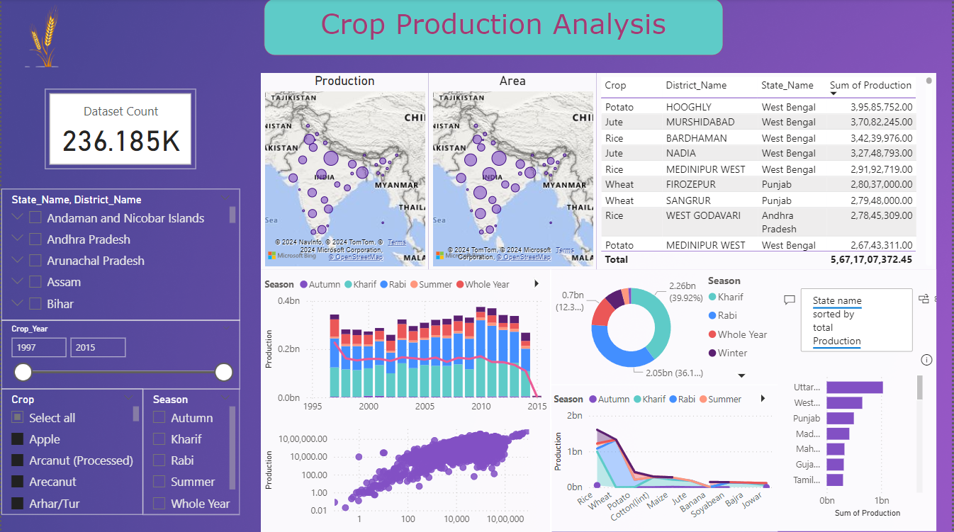

Slide 17
Thank You

